Slide 1
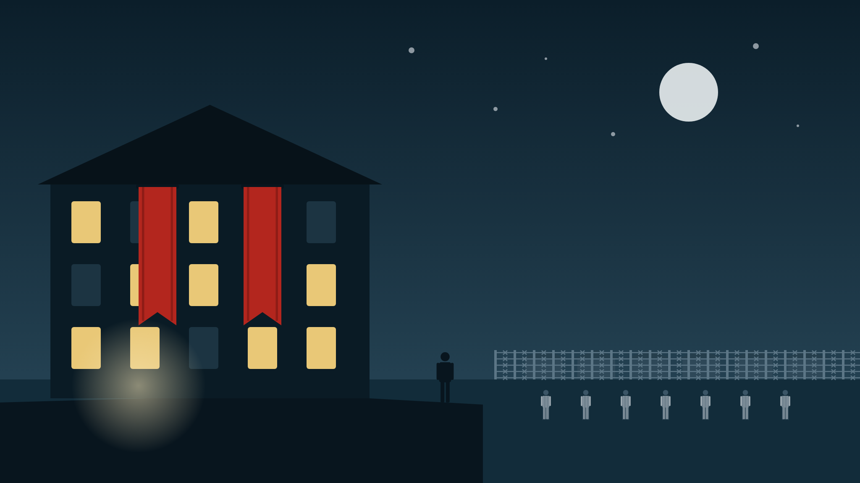
Notes:
SCRIPT (about 20 seconds): In The Boy in the Striped Pajamas, nationalism is everywhere, even before Bruno understands it. In chapters one to nine it moves his family, shapes his new home and builds a fence he can see from his bedroom window. I will show how nationalism slowly takes control of every part of Bruno's world.

Slide 2
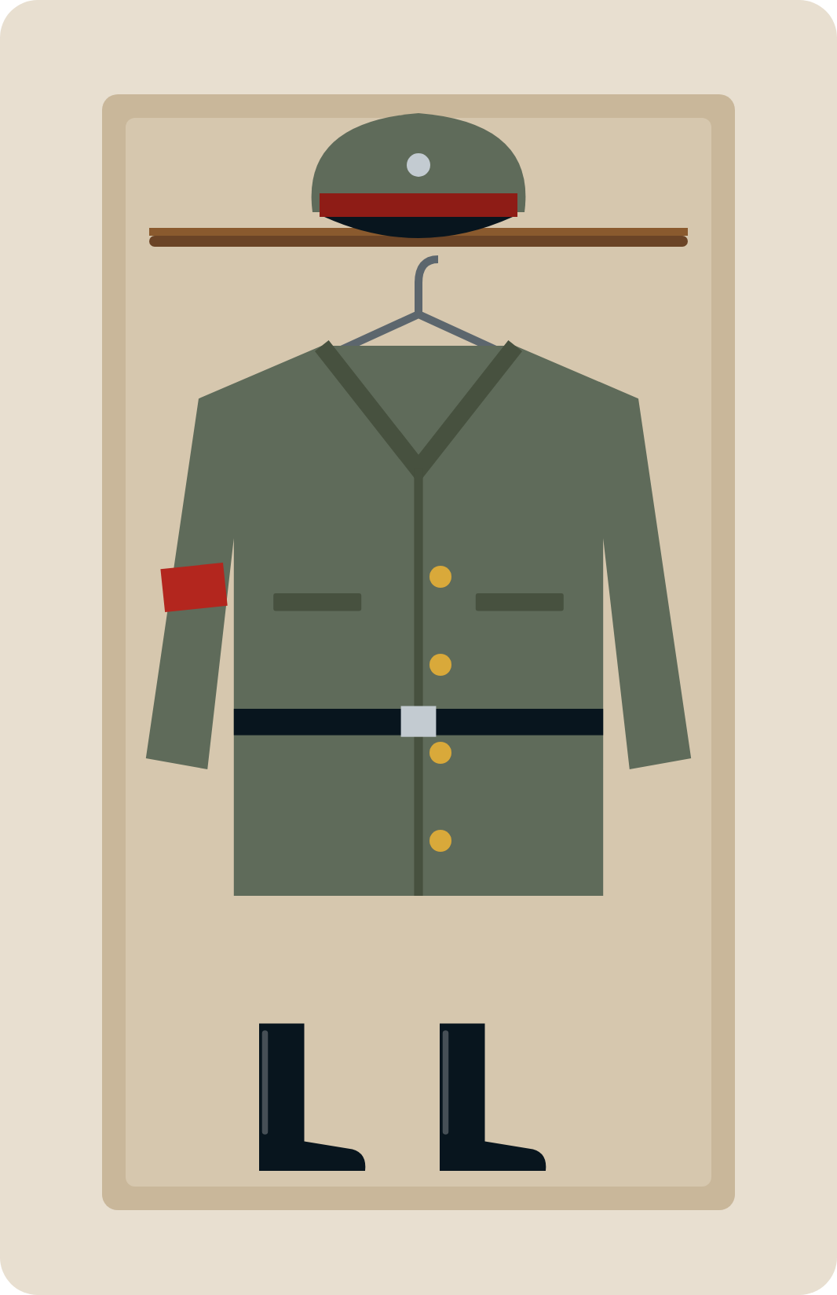

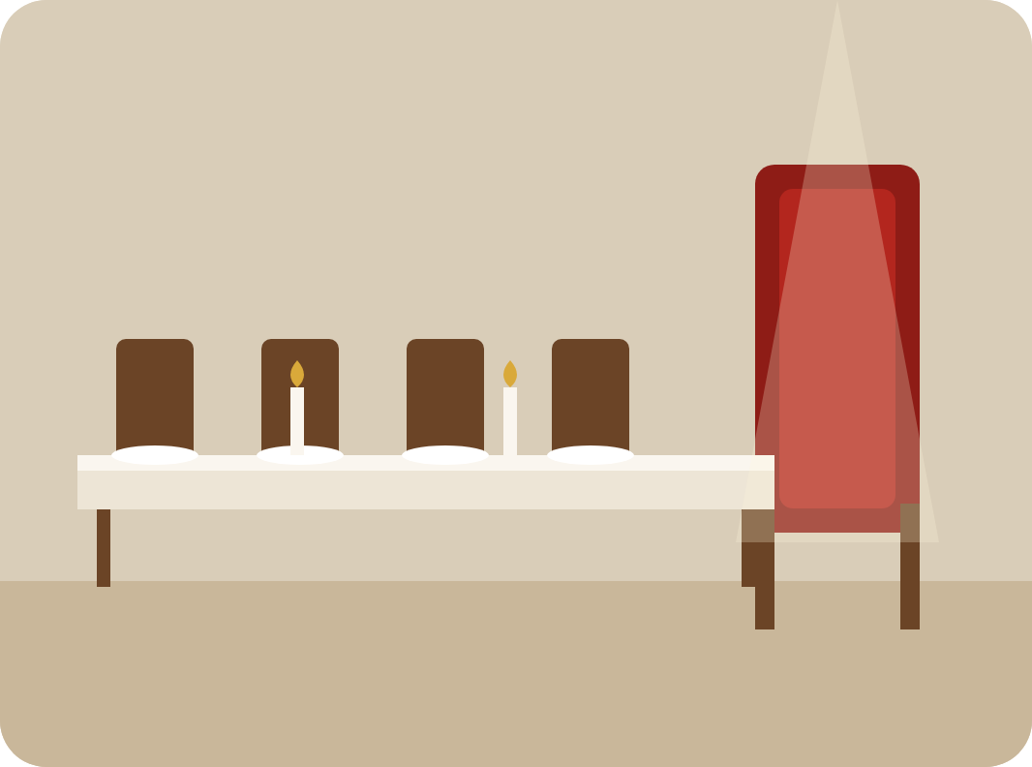
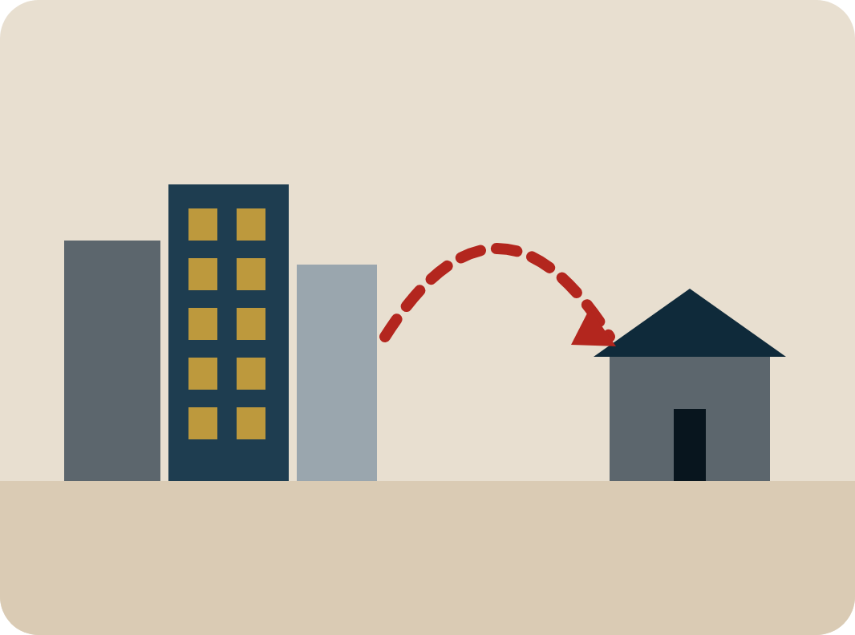
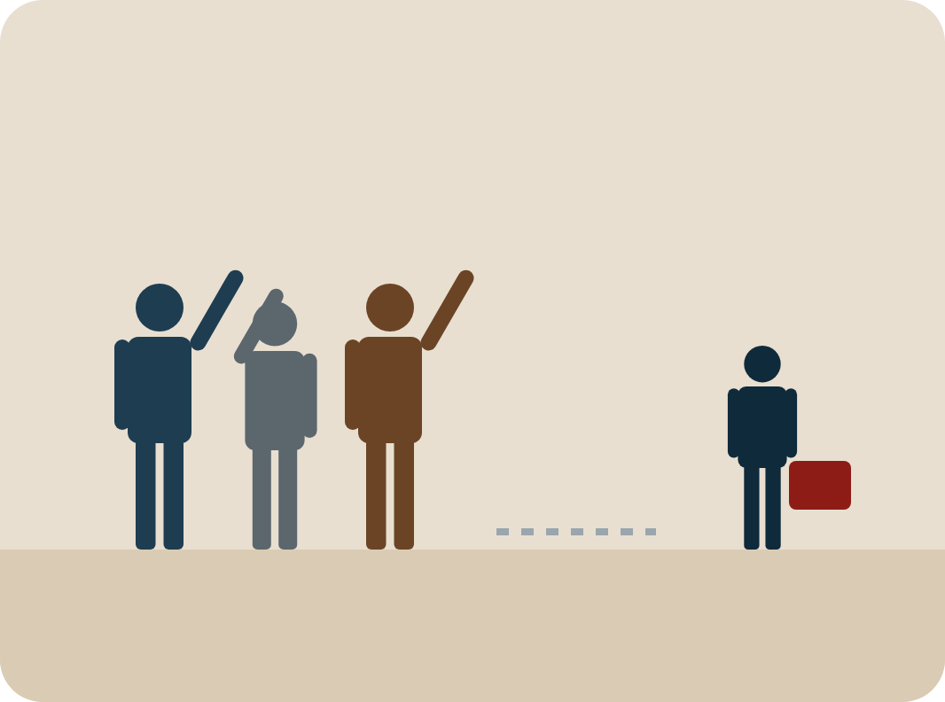
Notes:
SCRIPT (about 20 seconds): It starts in chapter one with Father's uniform. Because the Fury has big plans for him, the family packs up and leaves Berlin, and Bruno has to leave his three best friends for life. The Fury coming to dinner shows that loyalty to the nation comes before home, friends and childhood.

Slide 3
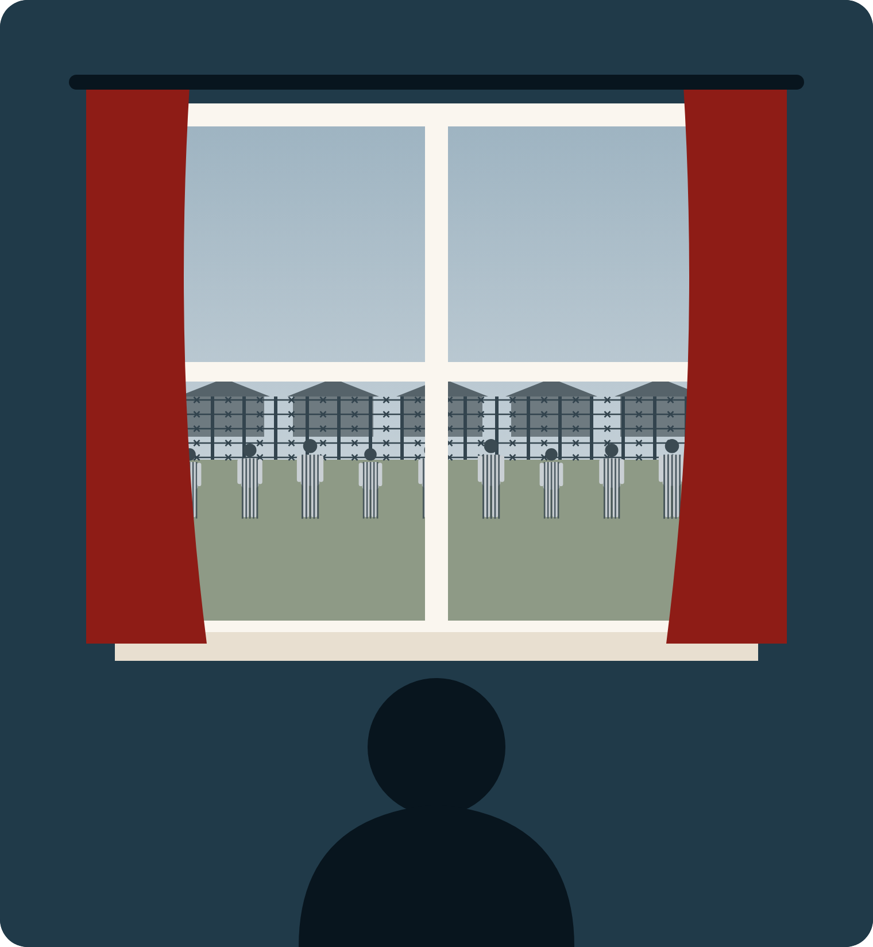
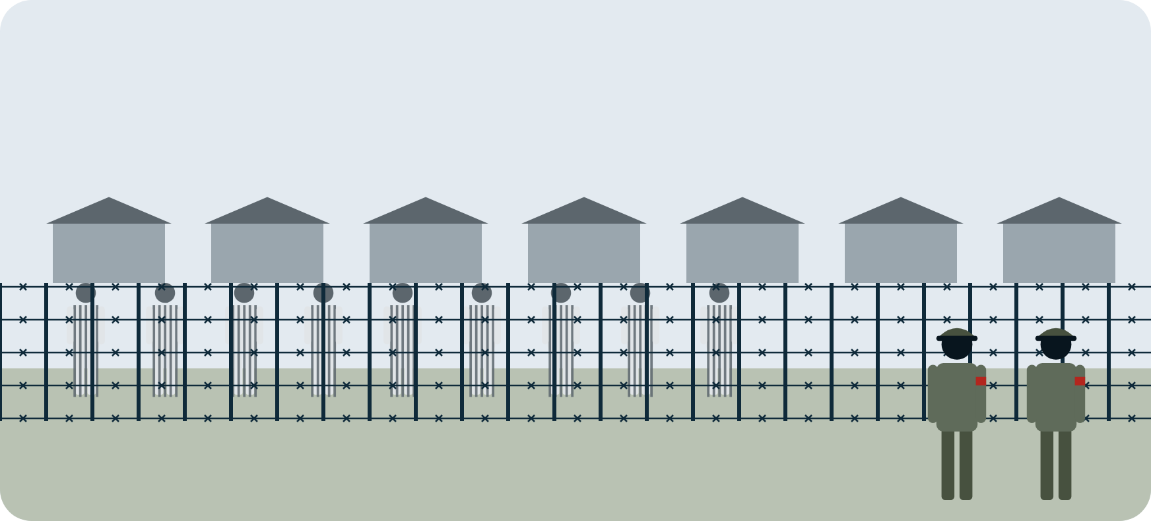
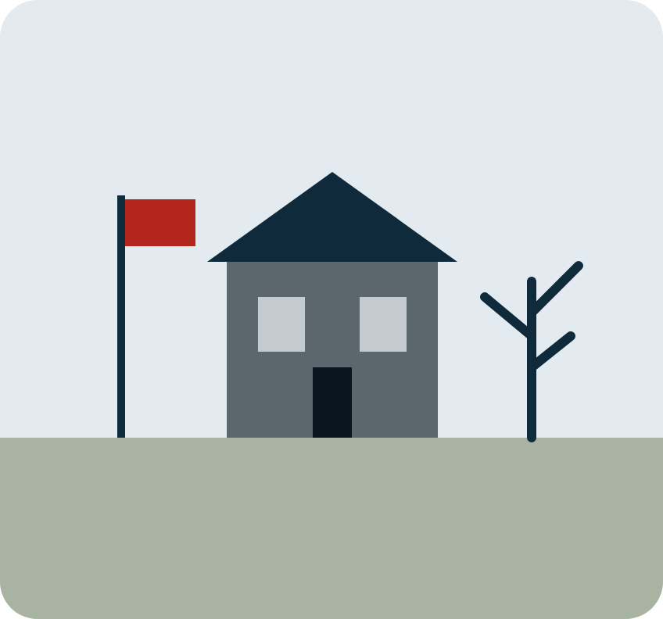
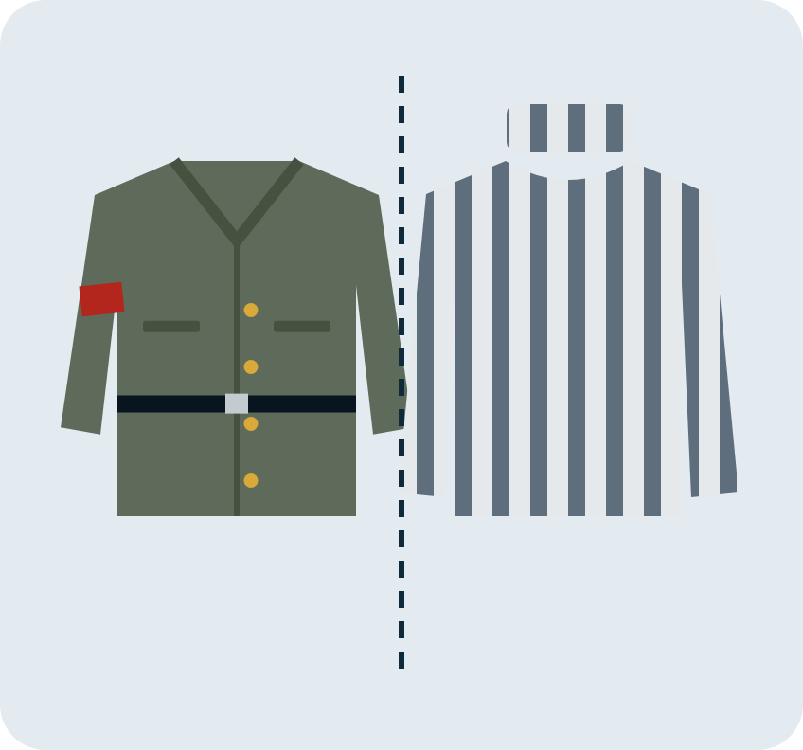
Notes:
SCRIPT (about 20 seconds): At Out-With there are no other houses, only a lonely house and a long fence. From his window Bruno sees people in striped pajamas and soldiers in uniform. Two kinds of clothes split people into us and them. Bruno is innocent, so he does not yet understand what the fence really means.

Slide 4

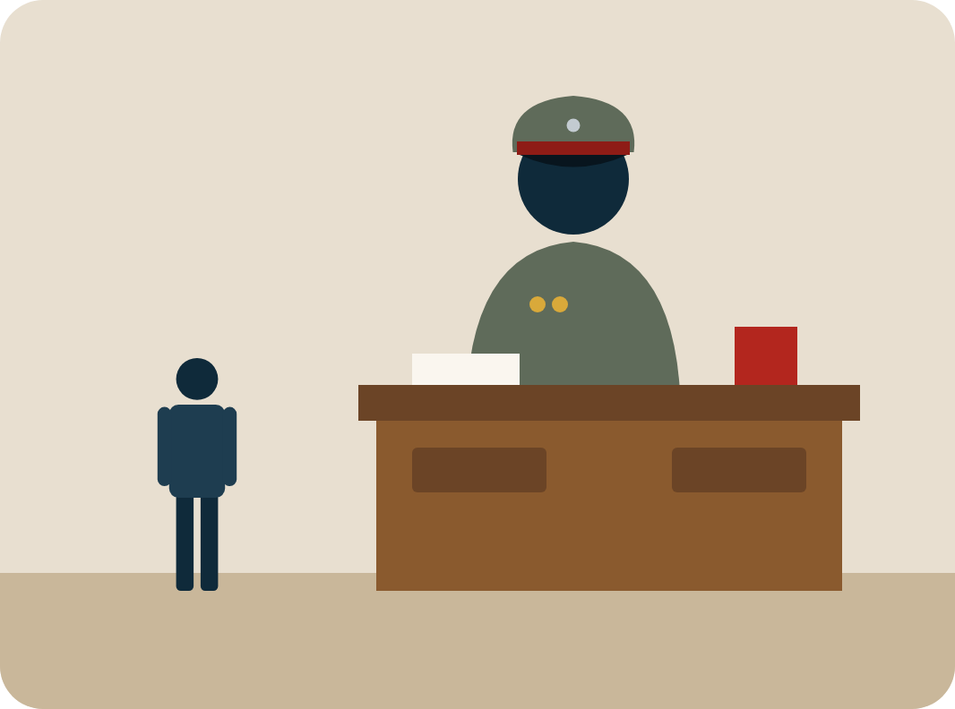
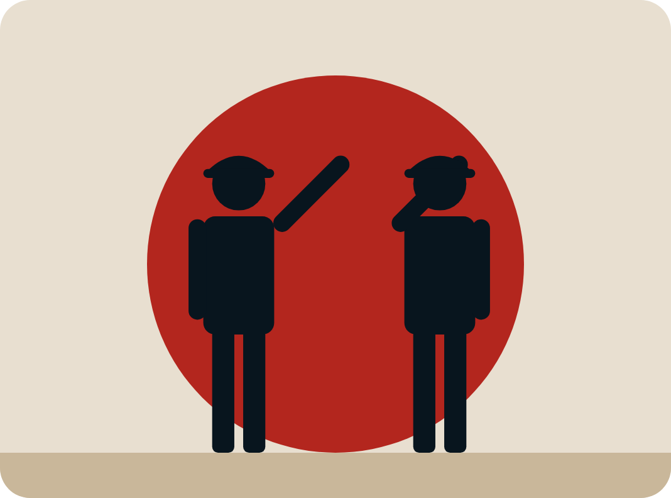
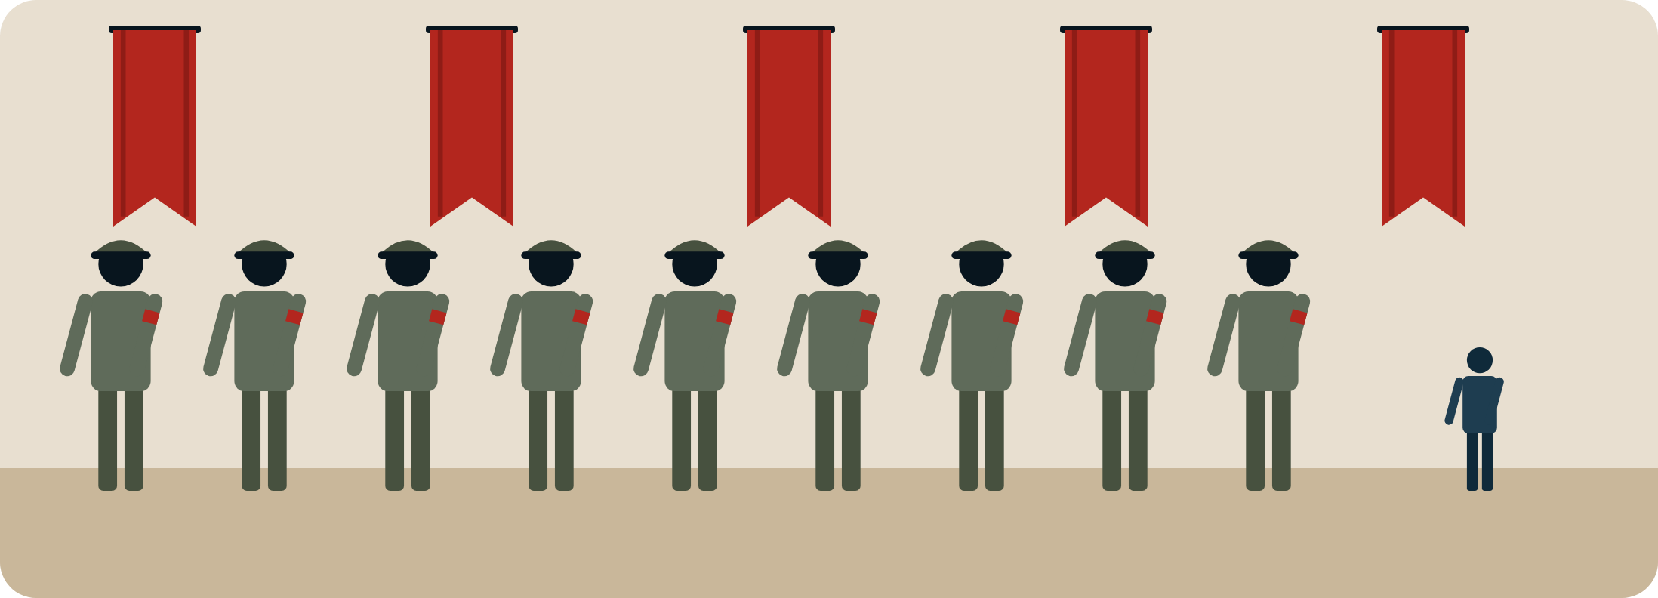
Notes:
SCRIPT (about 20 seconds): In chapter five, Father's office is Out Of Bounds At All Times And No Exceptions. When Bruno complains about the move, Father says they are there because of important work for their country, and the talk ends with a salute. Duty to the Fatherland matters more than his son's feelings, and Bruno learns to copy what he sees.

Slide 5


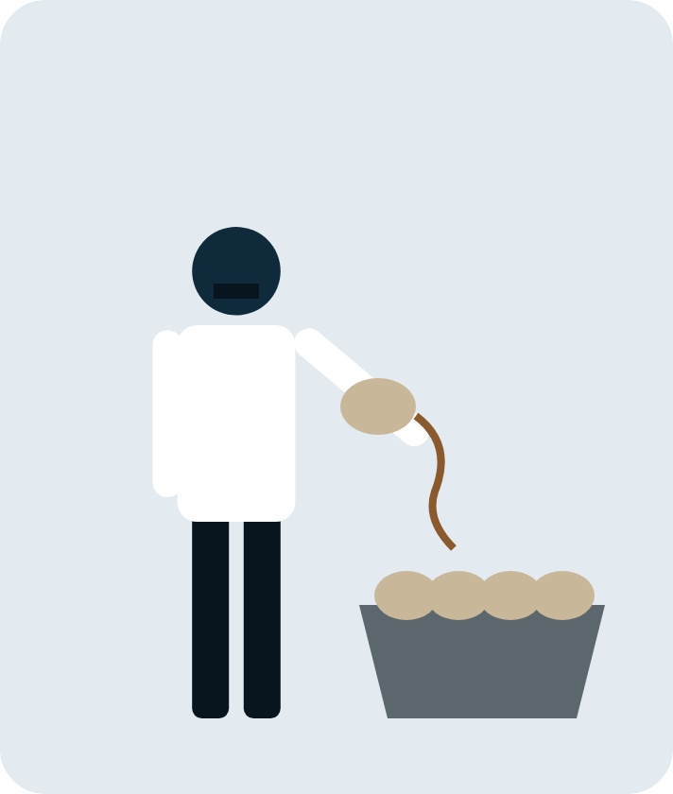


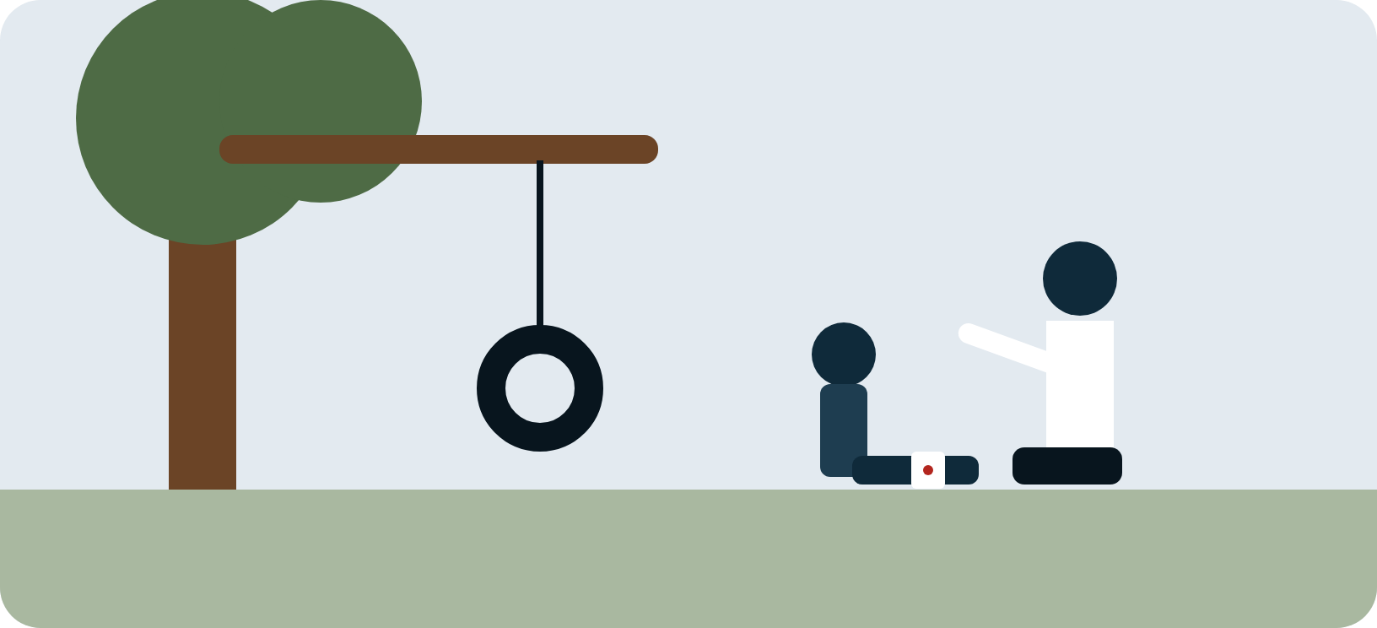
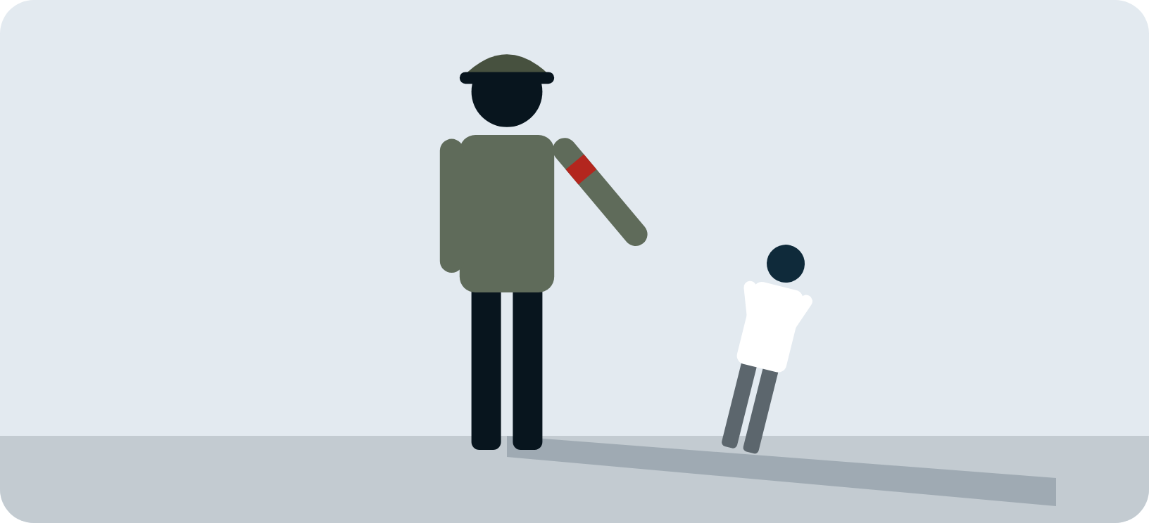
Notes:
SCRIPT (about 20 seconds): Chapters six and seven show who pays the price. Pavel was a doctor, but now he peels vegetables and waits at the table. When Bruno falls off his swing, Pavel cares for him gently, yet Lieutenant Kotler treats Pavel with contempt. Maria keeps quiet too. Nationalism decides who has power and who must stay silent.

Slide 6
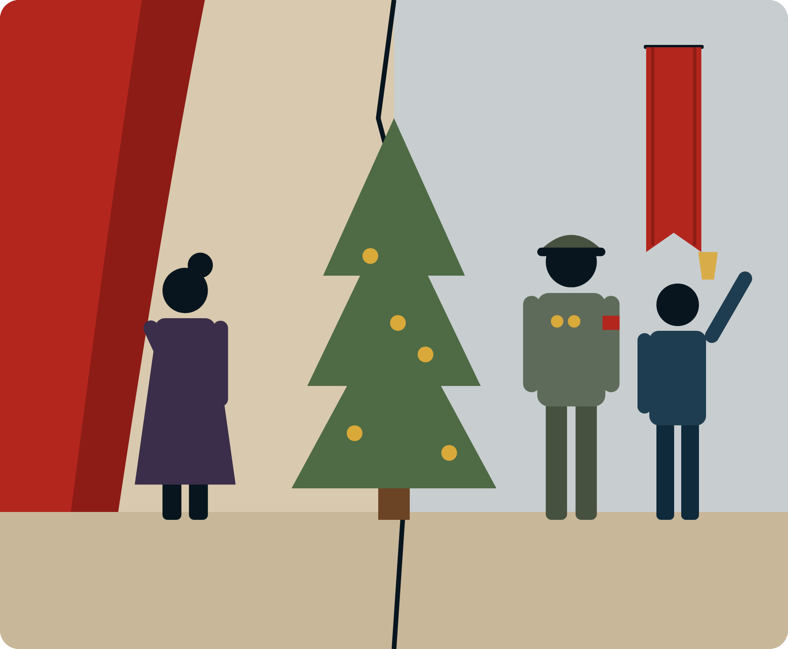
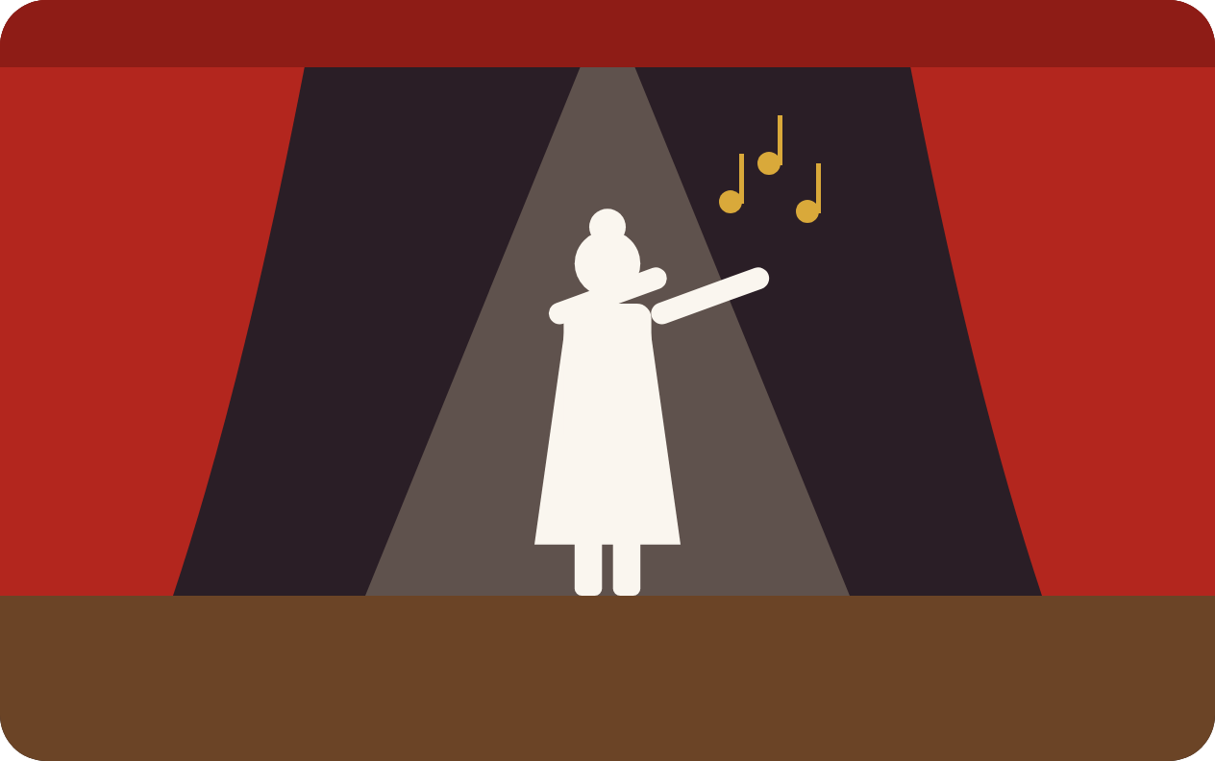
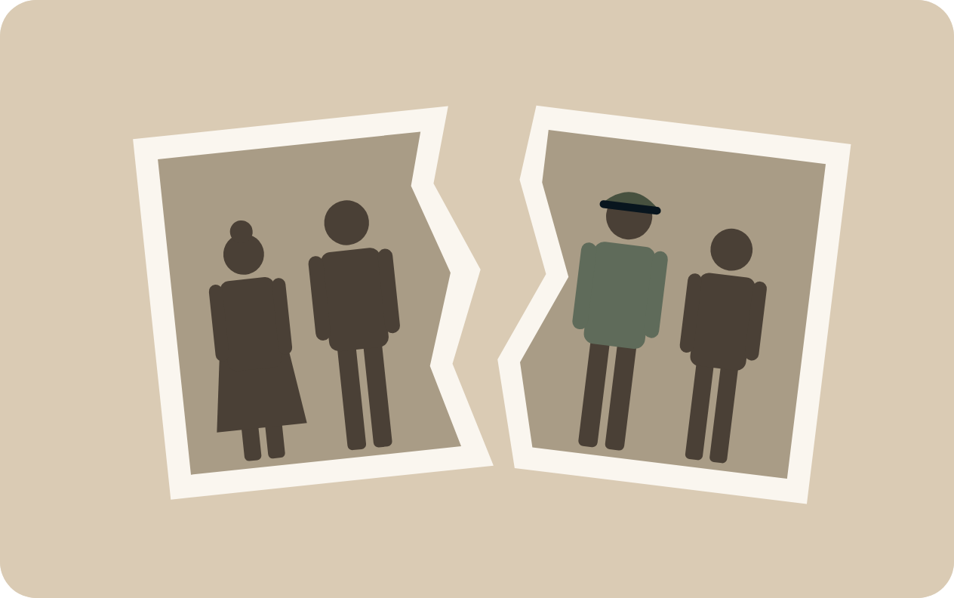
Notes:
SCRIPT (about 20 seconds): In chapter eight, nationalism splits Bruno's own family. Grandfather is proud of Father's new uniform, but Grandmother, a singer, is ashamed of it. At the Christmas party she tells her son exactly what she thinks of him and walks out. Boyne shows that nationalism can tear apart even the closest family.

Slide 7
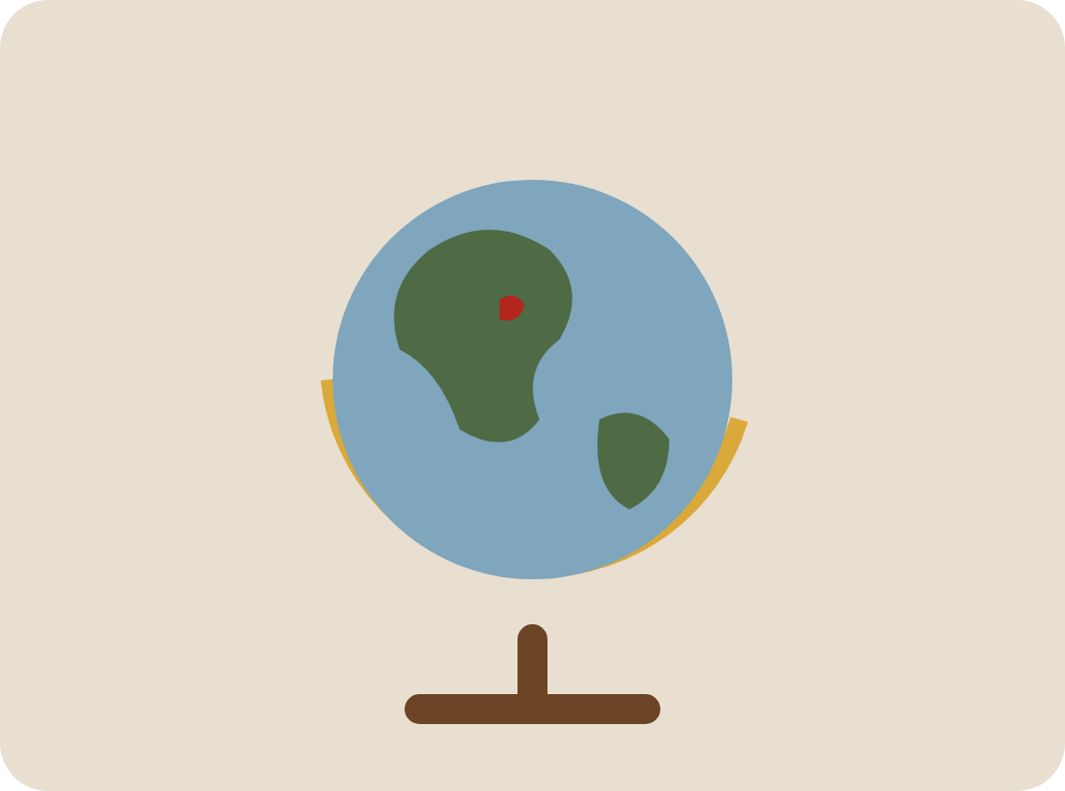

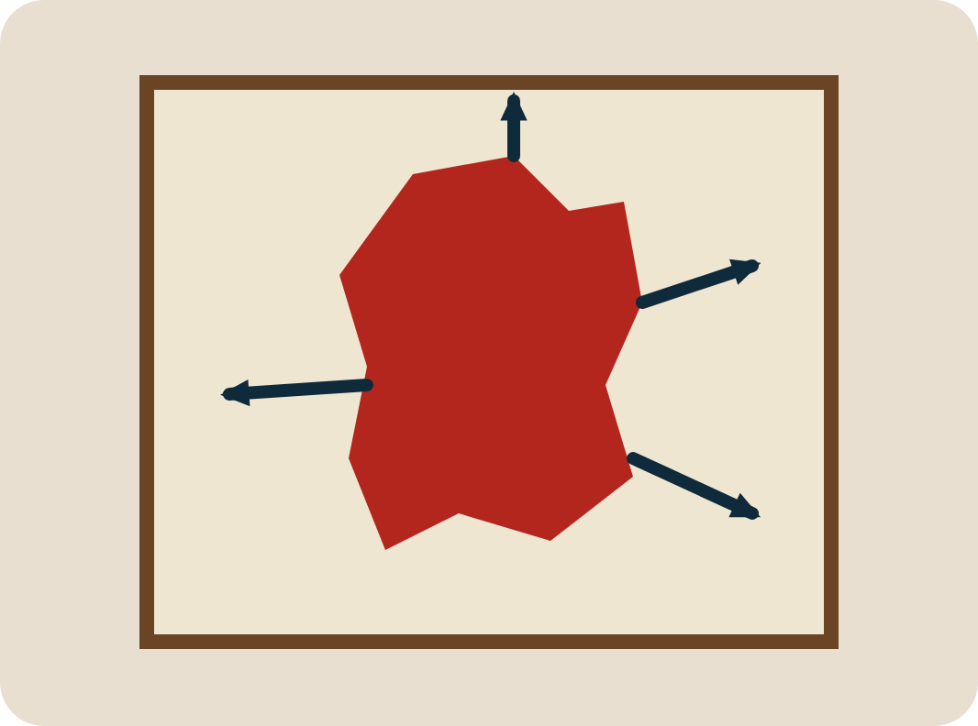
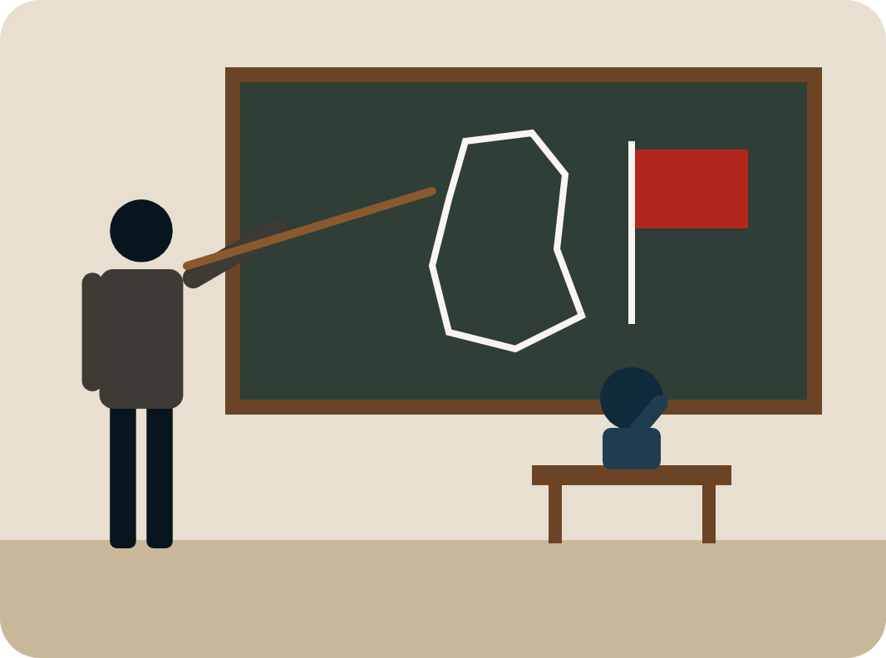

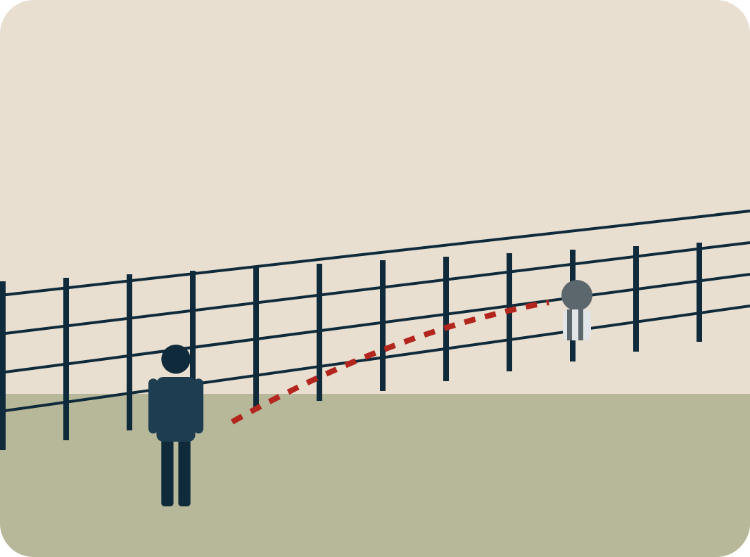
Notes:
SCRIPT (about 20 seconds): In chapter nine, Herr Liszt teaches history and geography to make Bruno proud of the Fatherland, instead of the reading and art Bruno loves. But Bruno remembers that he loves exploring. He follows the fence and finds a boy sitting on the other side. His curiosity is the first step past the walls nationalism builds.

